Slide 1
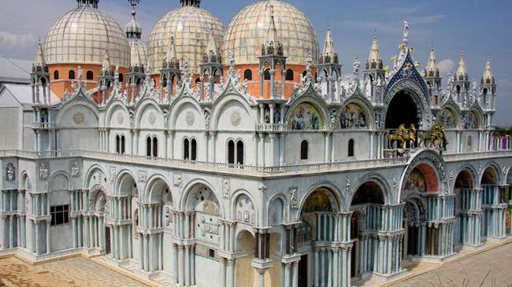
Najsłynniejsze budowle świata
Oliwia Cygan

Slide 2
Zhangjiajie Glass Bridge
It is a glass bridge, located in a national park in
China, which is the longest and highest located bridge in the world. The bridge is 430 meters long and hangs 300 meters above the bottom of Zhangjiajie Canyon. It is said to be delightfully beautiful and frightening at the same time.
The bridge was designed by architect Haim Dotan, originally from Israel.
The bridge can accommodate up to eight hundred people at the same time, and to intensify the impressions of tourists, it sways in a controlled way in the wind. Interestingly, it is also resistant to earthquakes.

Slide 3
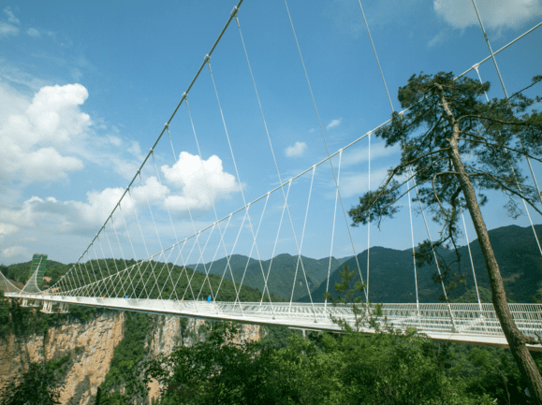
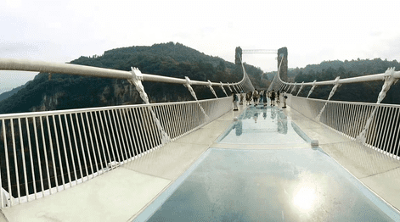
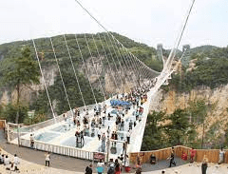

Slide 4
Burj Khalifa
It is the tallest building in the world and measures 828 meters.
The skyscraper is located in Dubai, United Arab Emirates.
The Burj Khalifa skyscraper was designed by the architectural
firm Skidmore, which also designed the Willis Tower and
World Trade Center.
Its general appearance refers to the culture of Islam.
The lowest floors were allocated to the hotel, which was decorated by Giorgio Armani.

Slide 5
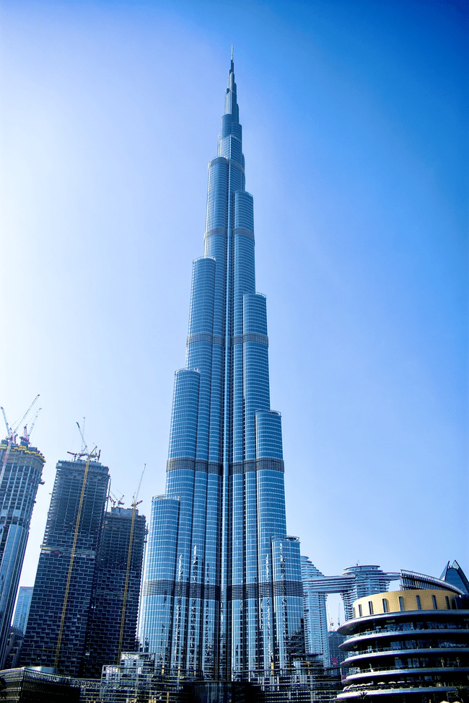
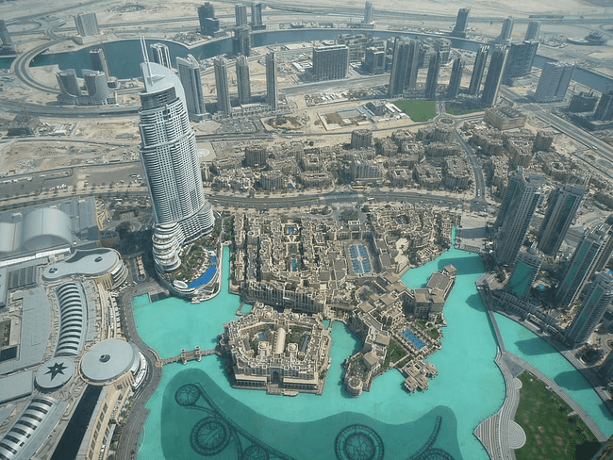

Slide 6
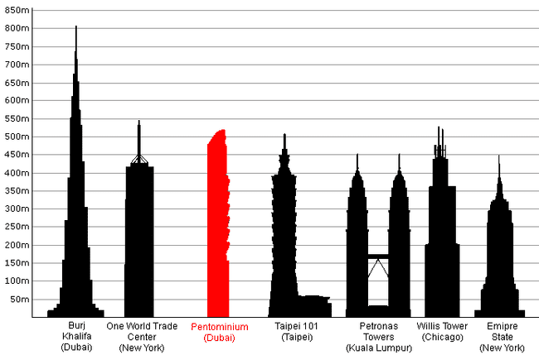

Slide 7
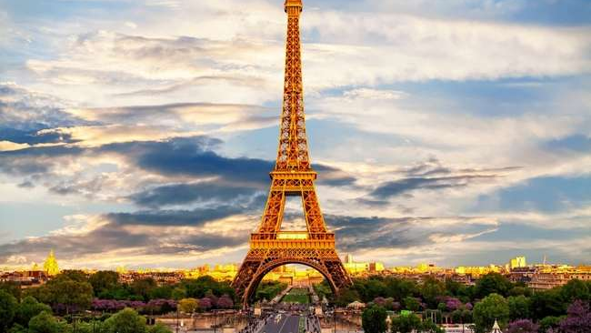
Eiffel Tower
This Photo by Unknown author is licensed under CC BY.

Slide 8
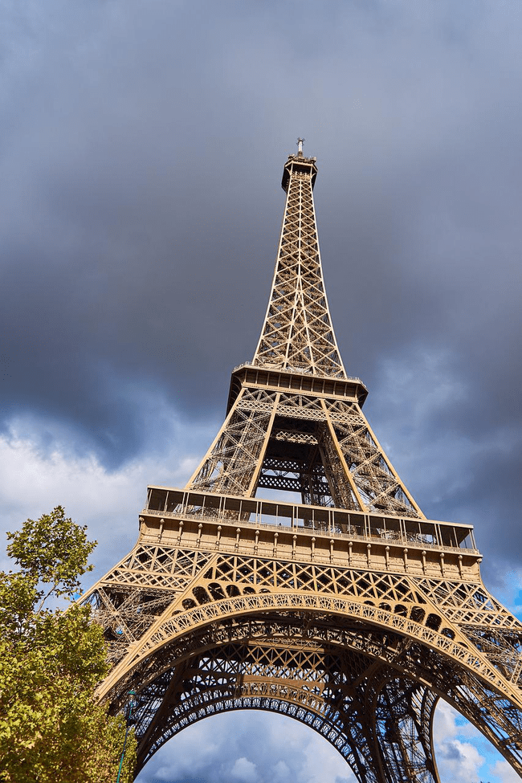
The most famous architectural object of Paris, which is its symbol and hallmark.
The tower is named after engineer Gustave Eiffel, whose company designed it.
It is the tallest building in Paris, and at the time of its creation it was the tallest building in the world.
The tower was built specifically for the Paris World Exhibition in 1889.
It was to commemorate the hundredth anniversary of the French Revolution and demonstrate the level of engineering knowledge and technical capabilities of the era.
Locally nicknamed "La dame de fer" (French for "Iron Lady"), it was constructed from 1887 to 1889 as the centerpiece of the 1889 World's Fair and was initially criticized by some of France's leading artists and intellectuals for its design, but it has become a global cultural icon of France and one of the most recognizable structures in the world.

Slide 9
The Colosseum
The Colosseum is an oval amphitheatre in the centre of the city of Rome in Italy, just east of the Roman Forum and one of the capital's most remarkable monuments. It is the largest ancient amphitheatre ever built, and is still the largest standing amphitheatre in the world today, despite its age. It is an imposing construction that, with almost 2,000 years of history
The three emperors that were patrons of the work are known as the Flavian dynasty, and the amphitheatre was named the Flavian Amphitheatre
The Colosseum today is a major tourist attraction in Rome with thousands of tourists each year entering to view the interior arena. There is now a museum dedicated to Eros in the upper floor of the outer wall of the building.

Slide 10
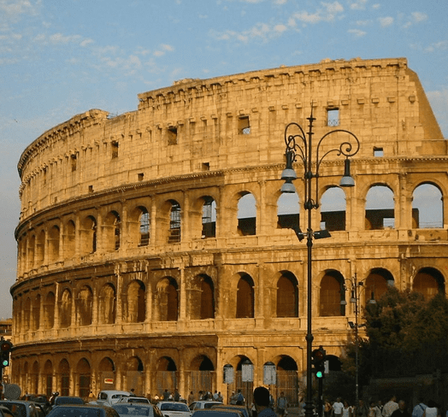
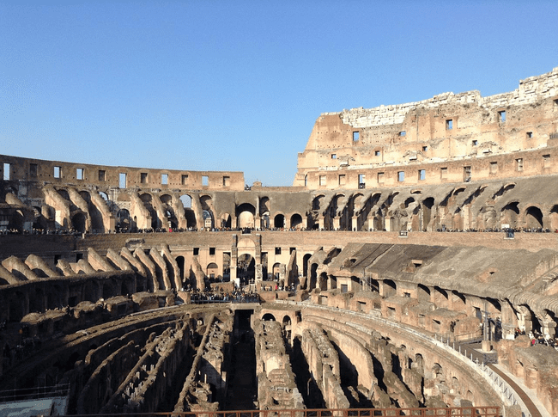
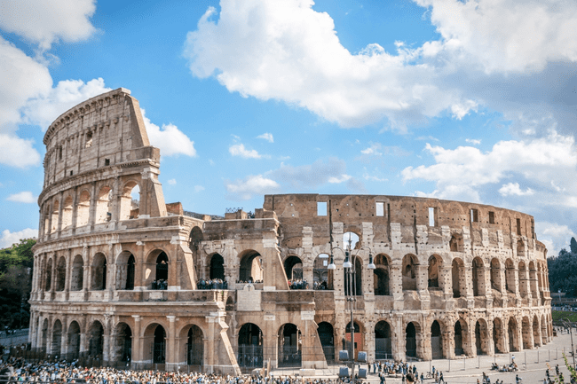

Slide 11
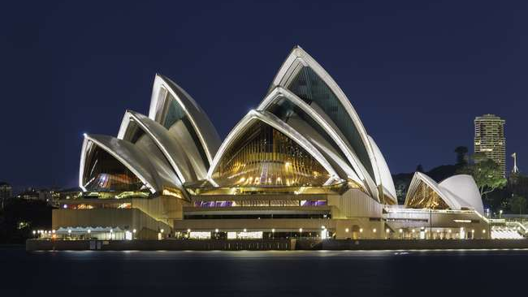
Sydney Opera House

Slide 12
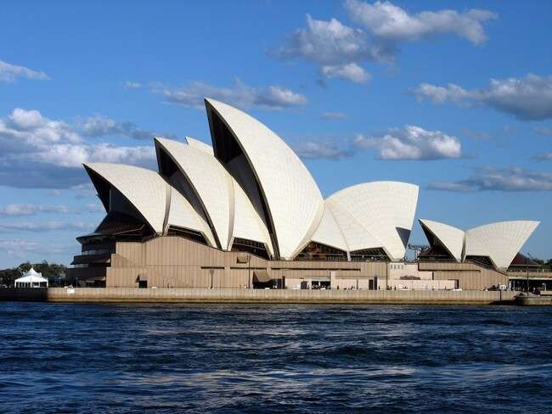
The Sydney Opera House is a multi-venue performing arts centre in Sydney. Located on the banks of Sydney Harbour, it is widely regarded as one of the world's most famous and distinctive buildings and a masterpiece of 20th century architecture.
The facility features a modern expressionist design, with a series of large precast concrete "shells", each composed of sections of a sphere of 75.2 metres. Forming the roofs of the structure, set on a monumental podium.
The Sydney Opera House includes a number of performance venues: concert hall, Joan Sutherland theatre, drama theatre, playhouse, studio, utzon room, outdoor forecourt and recording studio.

Slide 13
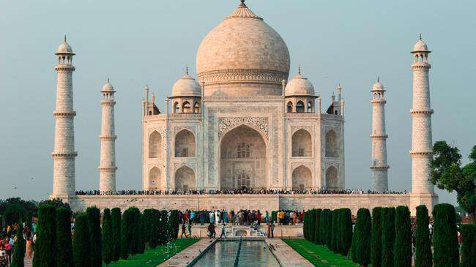
Taj Mahal

Slide 14
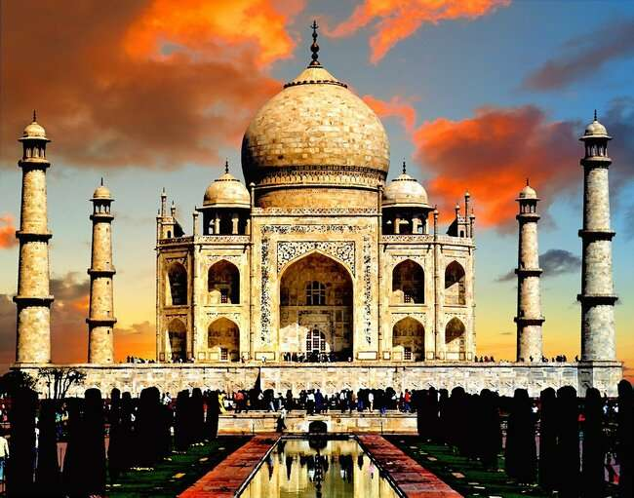
The Taj Mahal is a white marble built by Mughal emperor Shah Jahan in memory of his third wife, Mumtaz Mahal. In Arabic, the Taj Mahal is known as "crown of palaces". It is said to be the jewel of Islamic art in a nation that is predominantly Hindu.
It was built by a whopping 22,000 laborers, painters, stonecutters, embroidery artists. As if to show case the expanse of the Mughal Empire, it combines architectures from all the corners of the Empire including Islamic, Persian, Ottoman Turkish and Indian architectural styles. The interior chamber of the Taj Mahal reaches far beyond traditional decorative elements. The inlay work is not pietra dura, but a lapidary of precious gemstones.
Interesting fact is that the materials that were used to build Taj Mahal were transported to the construction site by a whopping 1,000 elephants.

Slide 15
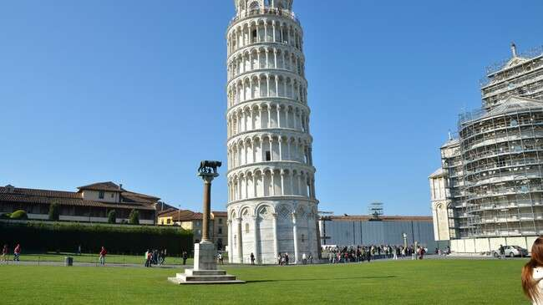
Leaning Tower of Pisa

Slide 16
Leaning Tower of Pisa or simply, the Tower of Pisa is the campanile, or freestanding bell tower, of Pisa Cathedral. It is known for its nearly four-degree lean, the result of an unstable foundation. The curiosity is the tower is one of three structures in the Pisa's Cathedral Square, which includes the cathedral and Pisa Baptistry.
At least four strong earthquakes have hit the region of the tower, but the apparently vulnerable Tower survived.
Why is it actually leaned?
The building of the Leaning Tower began in August 1173 with the building of the ground floor. The building began leaning as soon as the building reached the second floor in 1178. The leaning was as a result of a mere 3-meter foundation set on unstable soil.

Slide 17
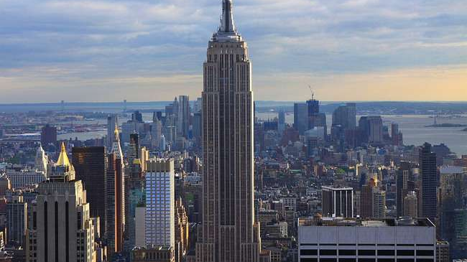
Thank you for your attencion!

Slide 18
Bibliografia
Szklany most w Zhangjiajie – Wikipedia, wolna encyklopedia
Taj Mahal - Wikipedia
Leaning Tower of Pisa - Wikipedia
Zdjęcia wykorzystane w prezentacji posiadają licencję Creative Commons

